Slide 1
CAMPUS SELECTION SYSTEM

Slide 2
TEAM MEMBERS
CUKOO BIJI
DEVI SREYA PS
HIBA THANSEEM
LISA LORANCE

Slide 3
PROJECT IMPLEMENTATION DETAILS
Backend software
Using java
The project contains the following main modules.
WELCOME MODULE
ABOUT US MODULE
STUDENT LOGIN MODULE
REGISTER MODULE
ADMIN LOGIN MODULE
STUDENT DATA MODULE
CONTACT US MODULE

Slide 4
DESCRIPTION
A college campus recruitment system includes student and admin logins, catering to students, companies, and the college placement officer. Students create profiles, upload details, and view company listings. Admins manage student accounts, ensuring accuracy, and oversee the system, moderating and deleting non-compliant data. The system efficiently handles student and company data, filtering student databases based on company requirements. Students register for drives, providing details and marks. Management filters student data according to company needs, facilitating company access.

Slide 5
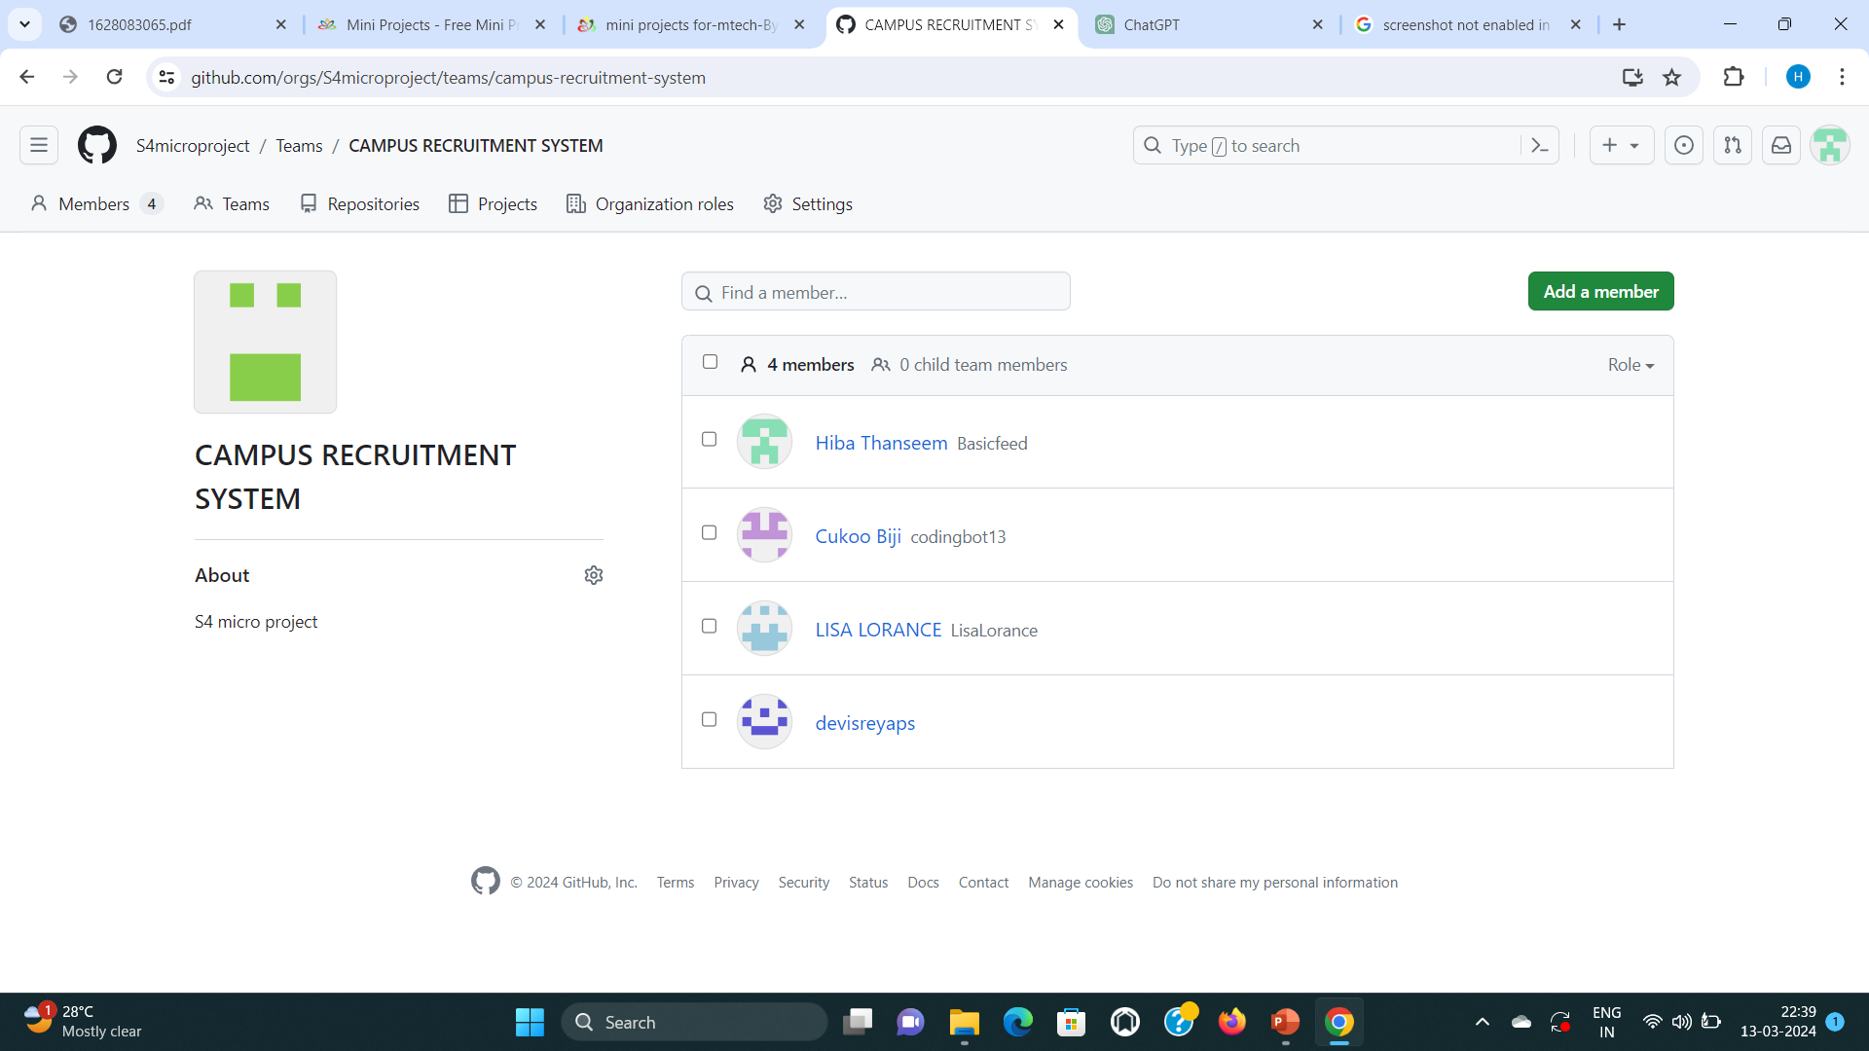
GITHUB PROFILE

Slide 6
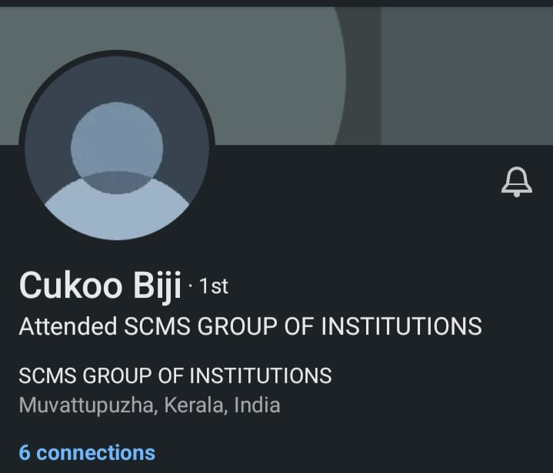
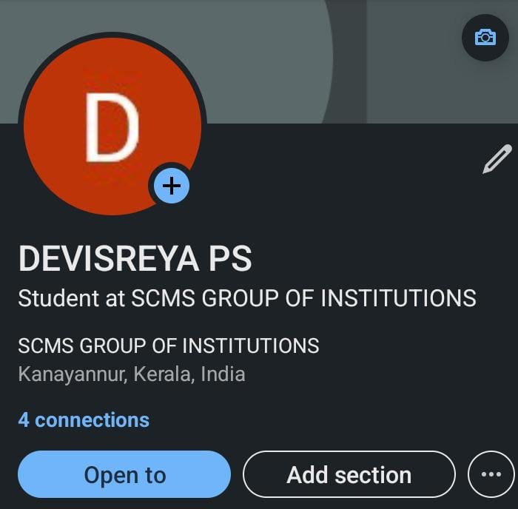
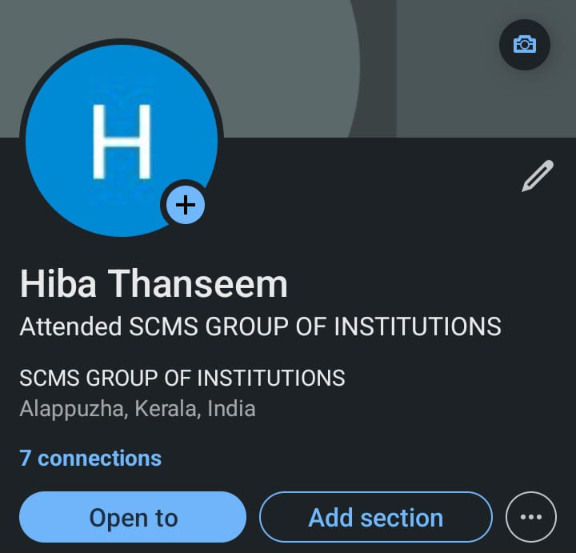
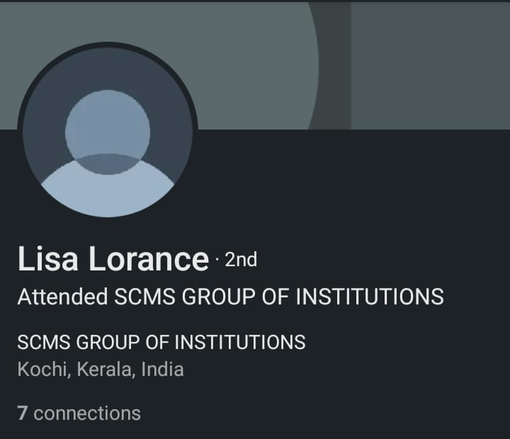
LINKEDIN PROFILE

Slide 7
THANK YOU

